Slide 1
CSE 11 Accelerated Intro to Programming Lecture 6
Greg Miranda, Summer 1 2021
This lecture is being recorded

Slide 2
Announcements
PA3 due Thursday @ 11:59pm
Quiz 3 released today @ 11am
Due Friday @ 11:59pm

Slide 3
Memory Models
More practice with drawing diagrams for laying out objects
Build up a little more of a visual language for
Drawing objects
Drawing what’s happening inside Java
Code from the reading

Slide 4
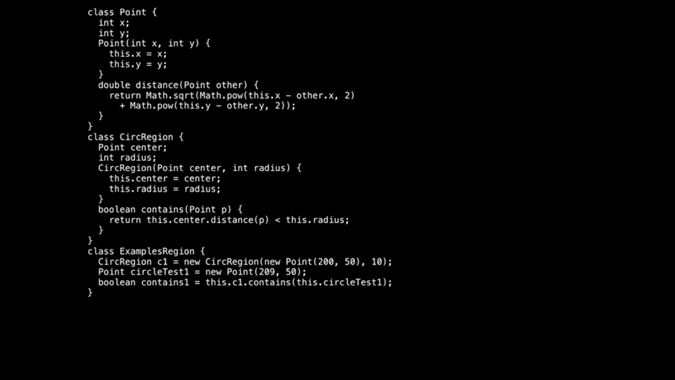

Slide 5
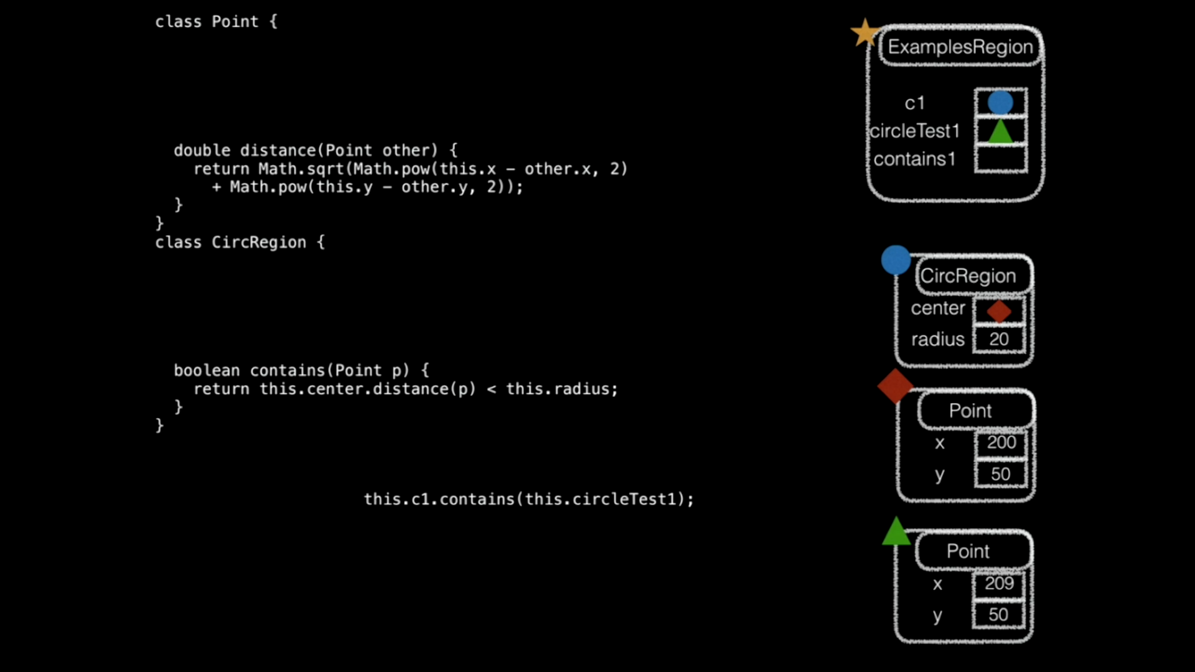

Slide 6
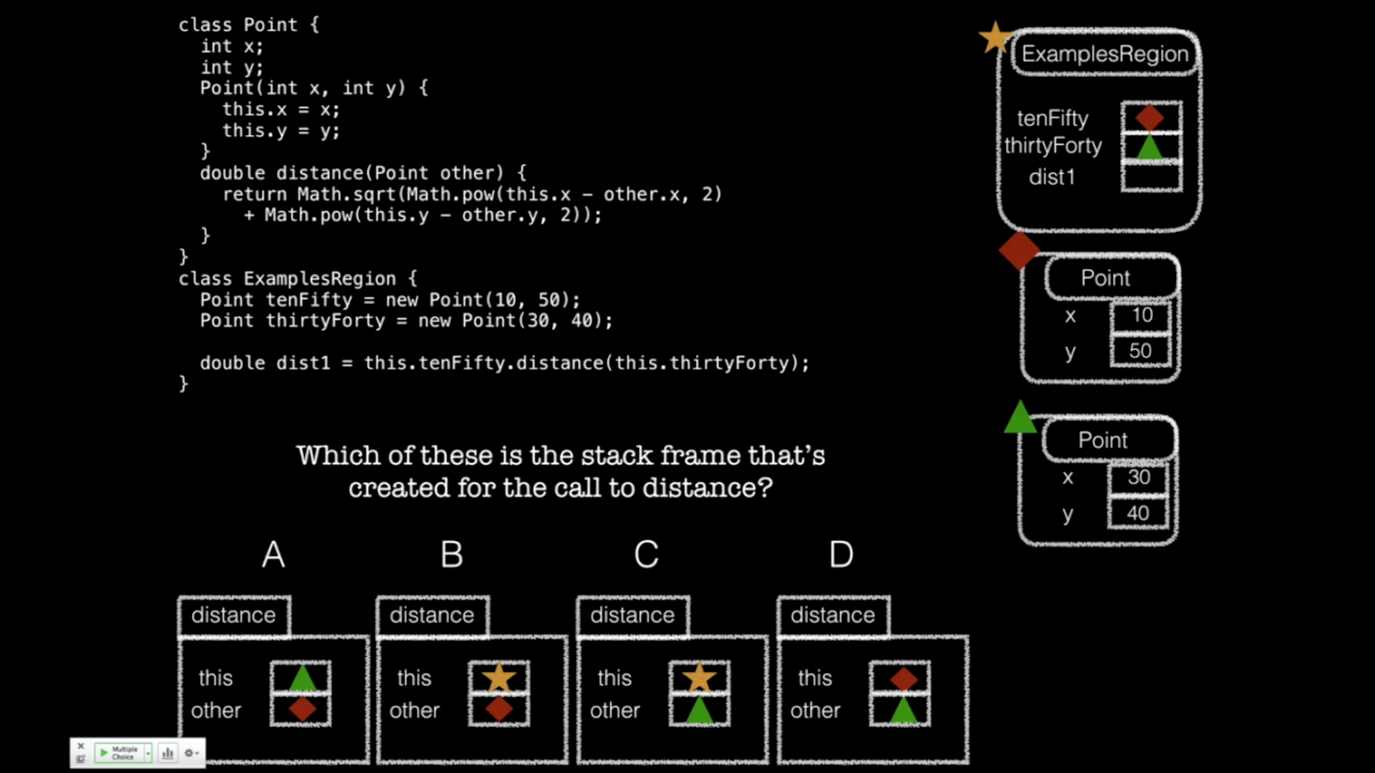




Slide 7
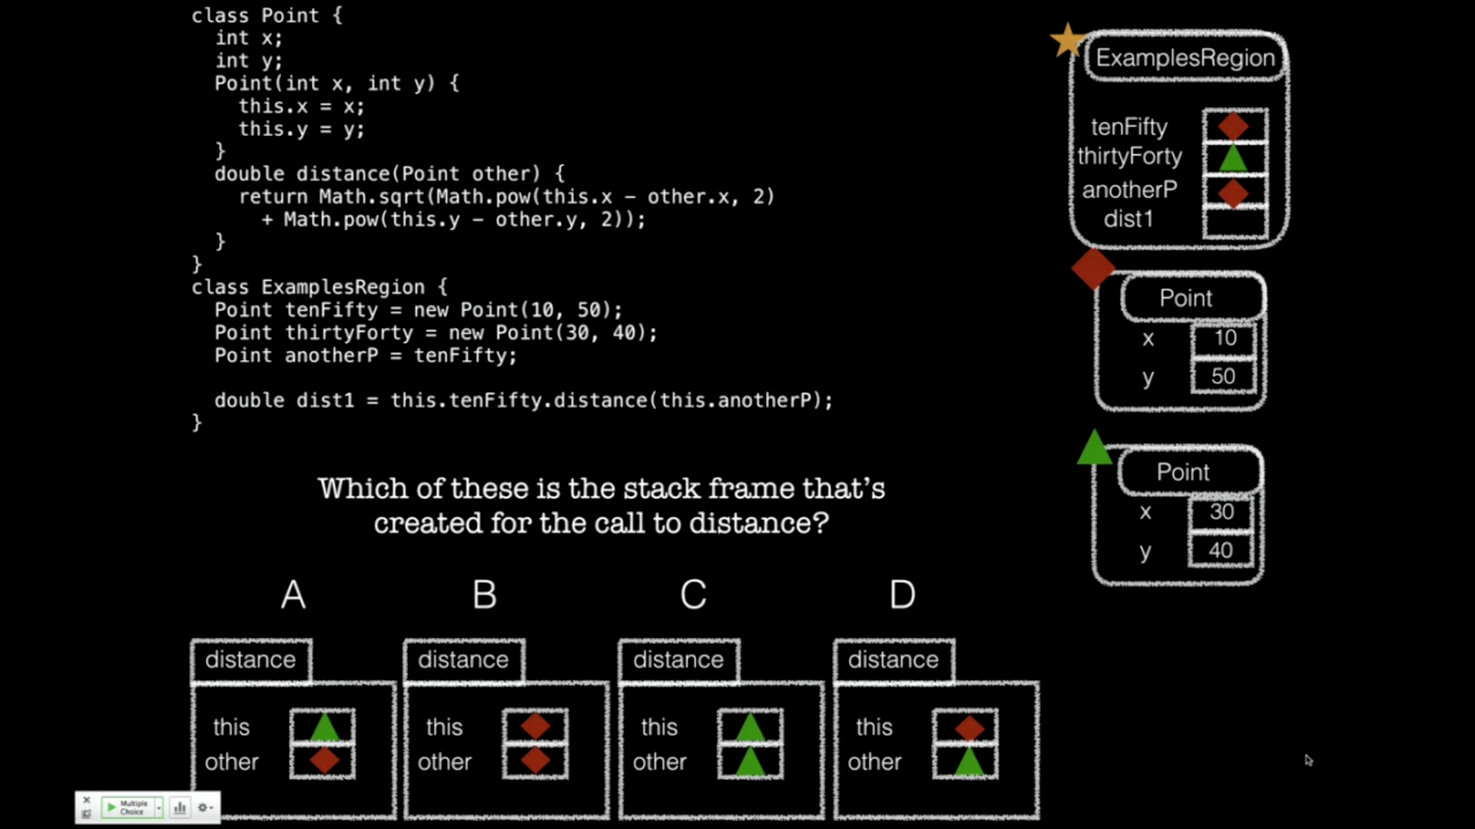




Slide 8



Constructors
Now that we understand the Stack, we have what we need to understand constructors

Slide 9
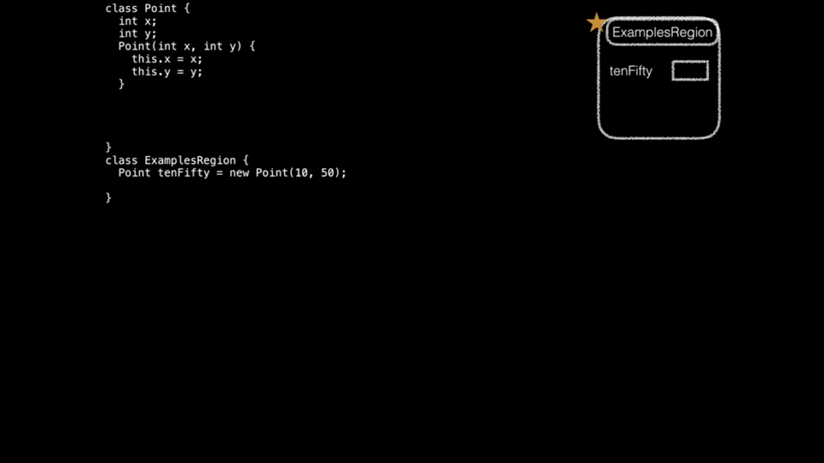

Slide 10

Constructor Summary
Constructors:
Are special methods, called when new is used
Are passed the newly-constructor object as this, and any arguments
Typically assign values into fields using this.field = value
When new is used:
A fresh object, with a new reference is created with uninitialized fields
The constructor with parameters that match the arguments is called
The whole new expression evaluates to the new reference

Slide 11
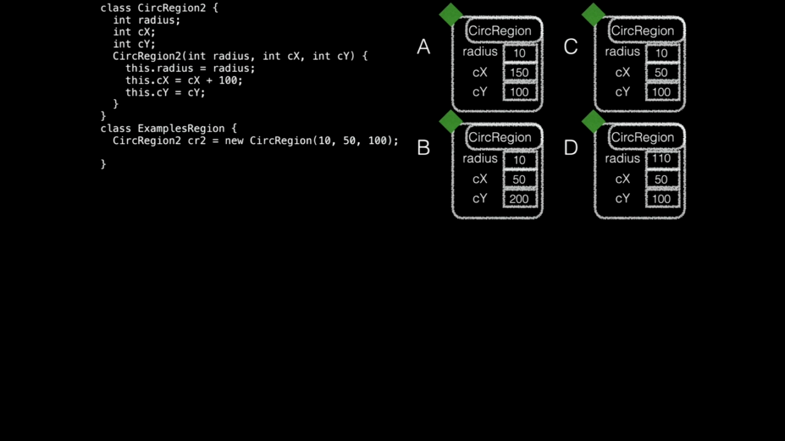

Slide 12
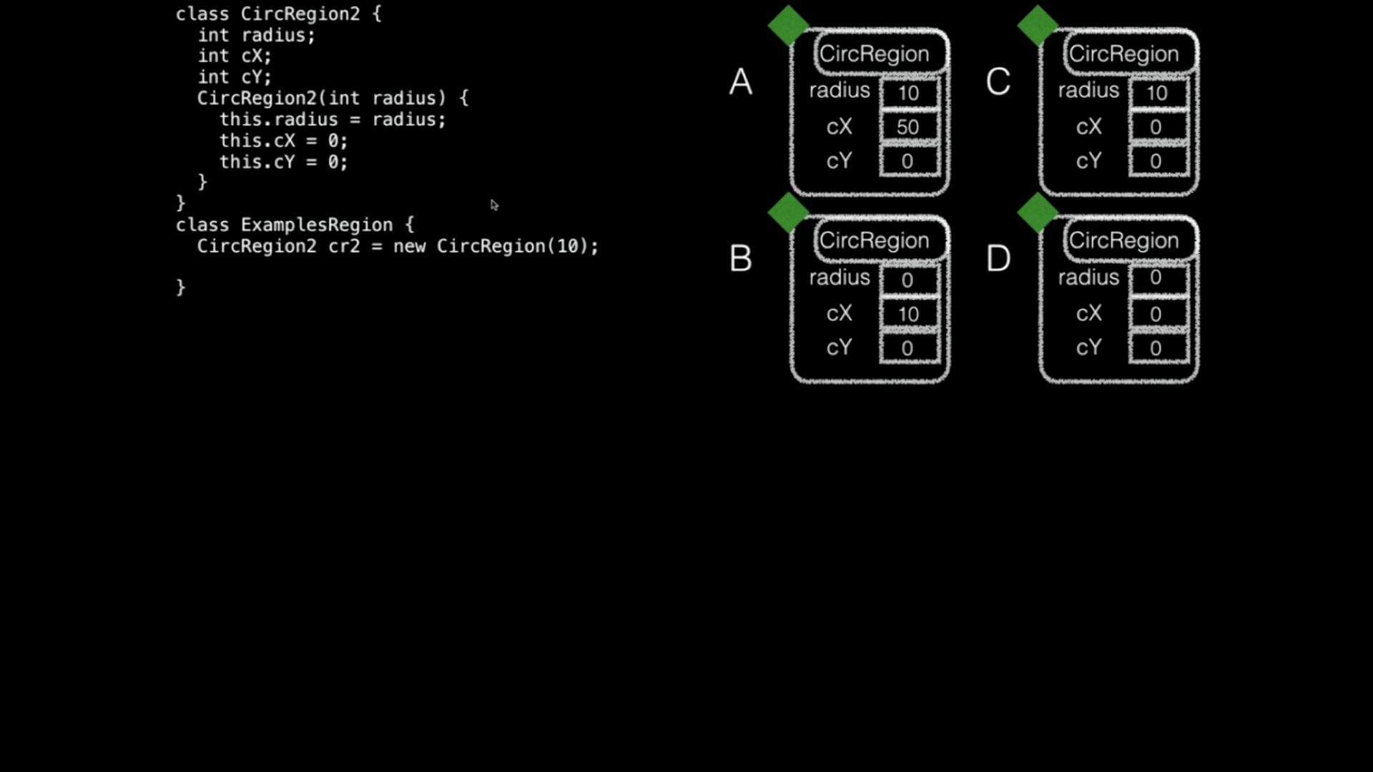

Slide 13

Tester
import tester.*;
tester.jar – java archive
Libraries that contain classes that we can use in our own code
Tester
Tester class allows us to create methods to unit test our code
Unit testing – compare actual values versus expected values
t.checkExpect(<actual value>, <expected value>);
Goal: get all tests to pass
Confidence that your code/solution is correct

Slide 14
Local Variables
Local variables are defined inside the body of a method
They are ‘local’ to the method in which they are defined in
Used temporarily while the method is running, then are removed
Similar to parameters
Added to the stack frame for the method
No default value
Must be assigned a value before it’s read from
i.e. used as an expression

